Slide 1


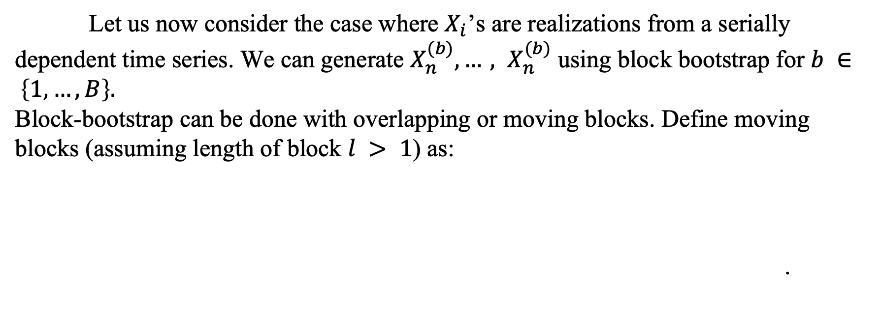
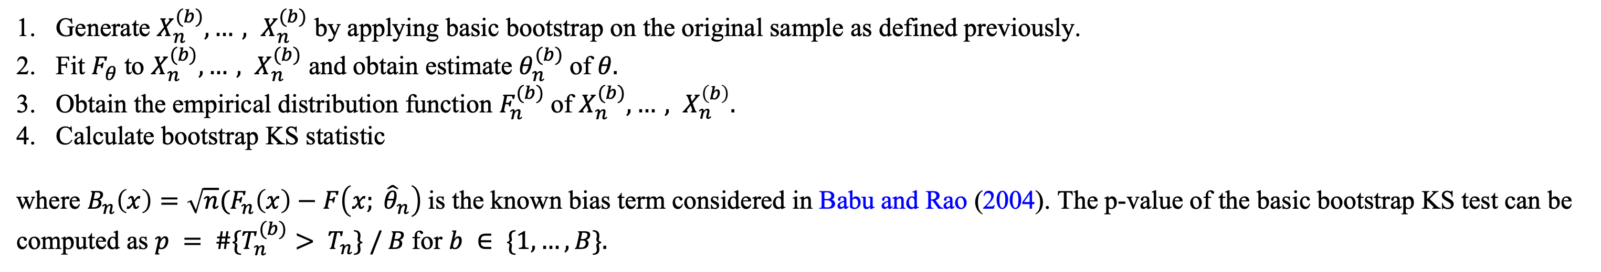
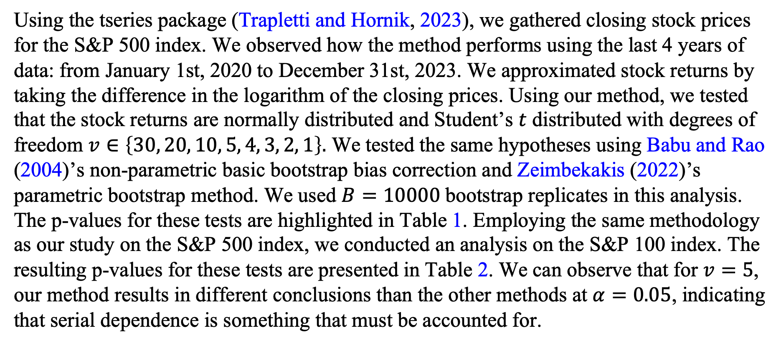
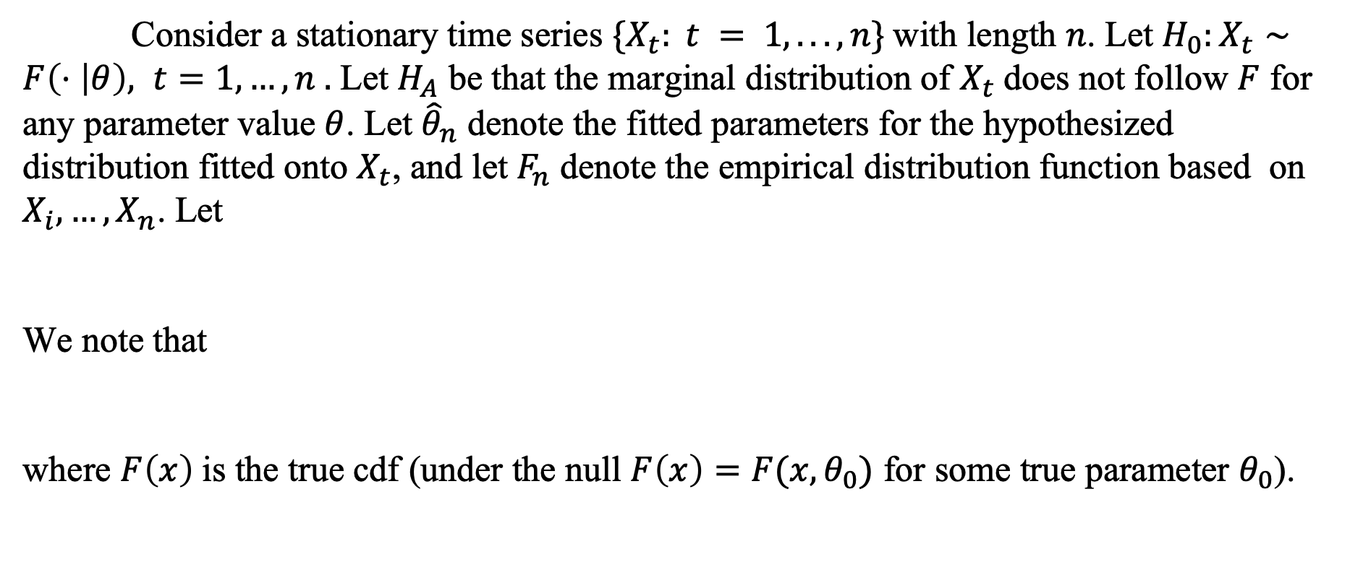
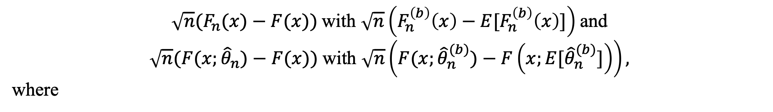
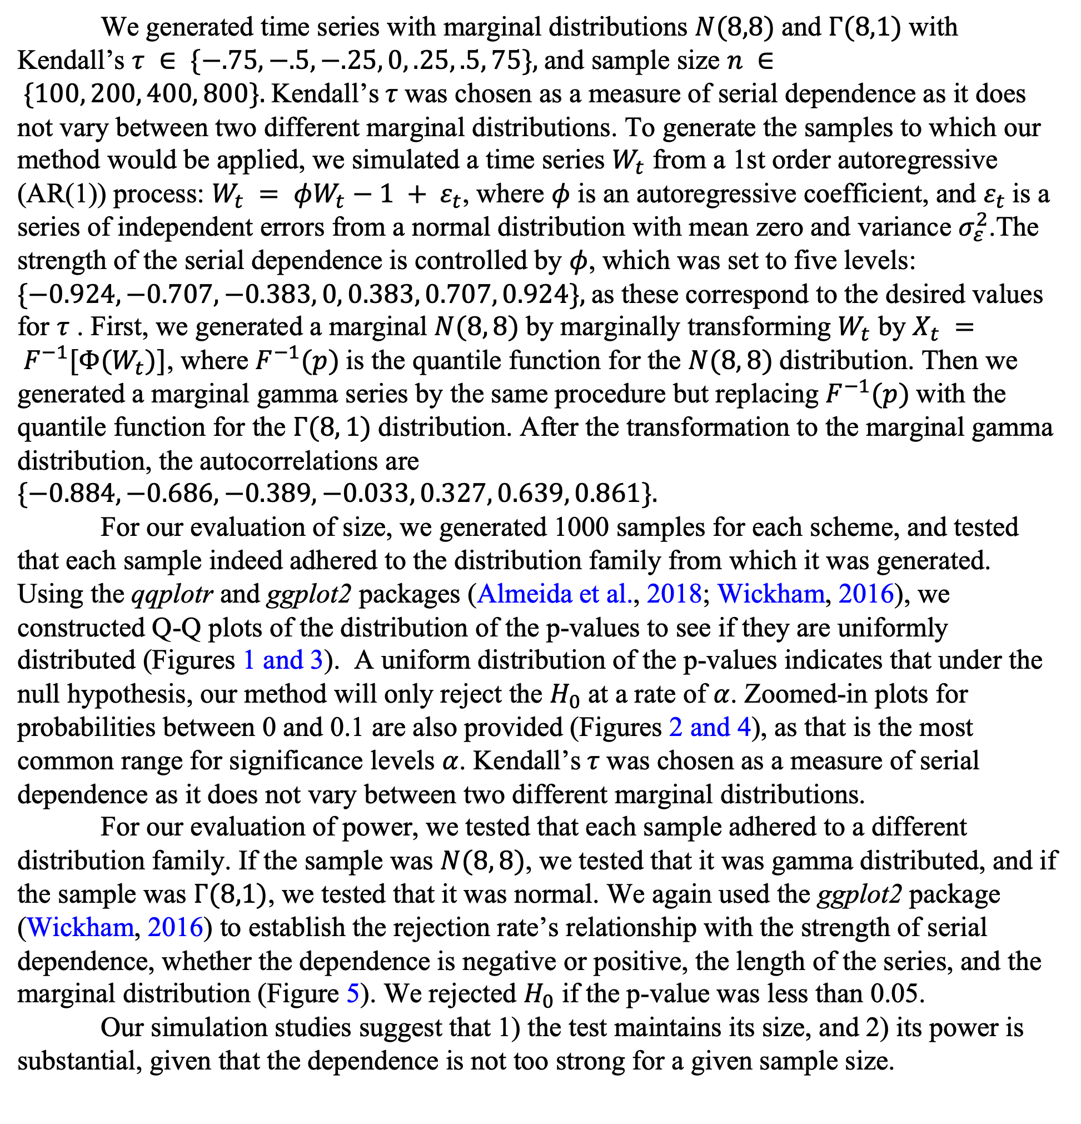
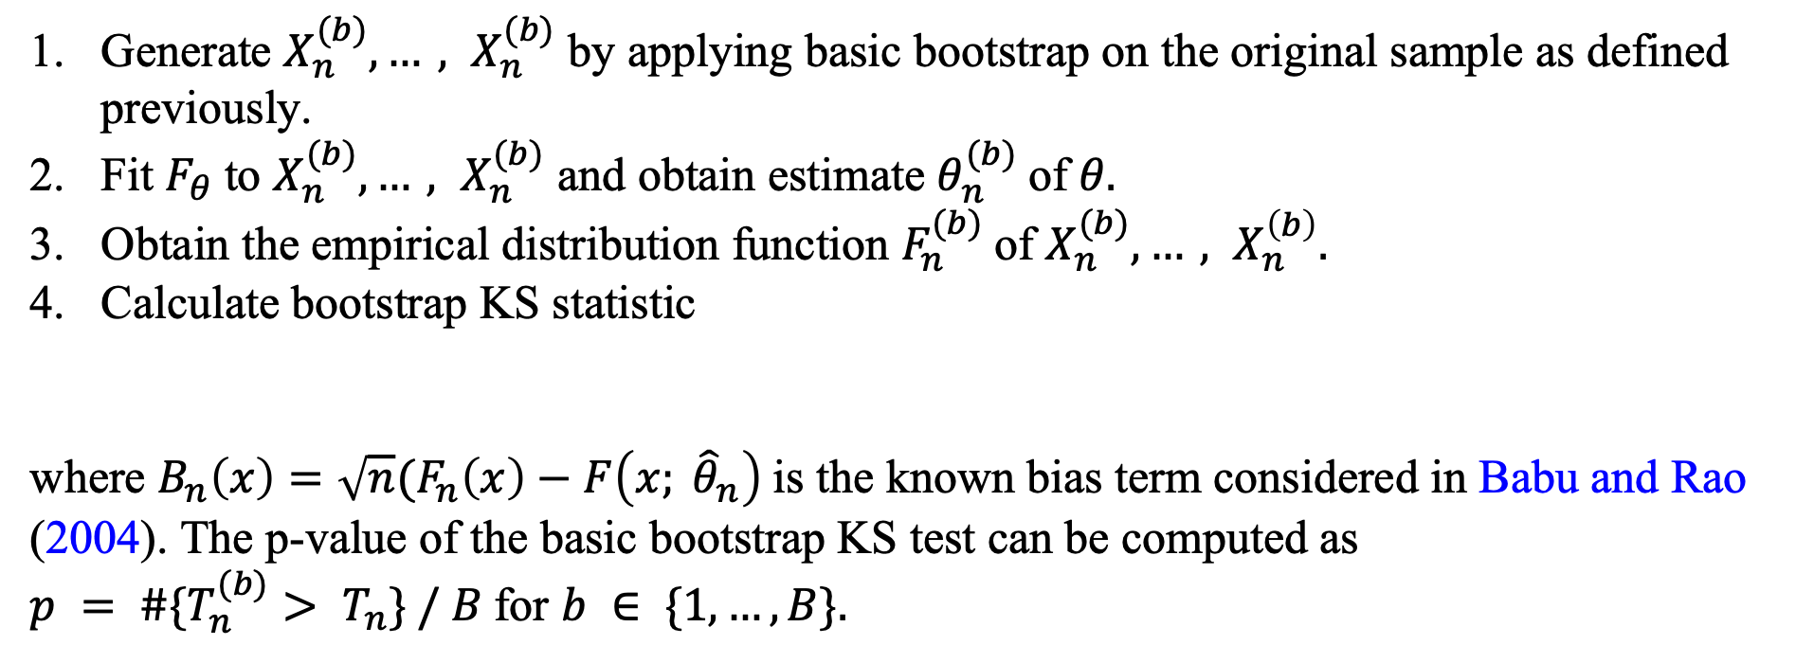


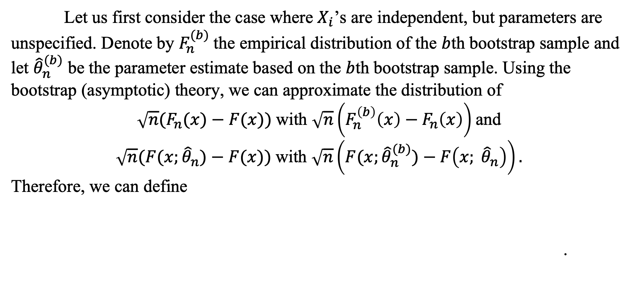
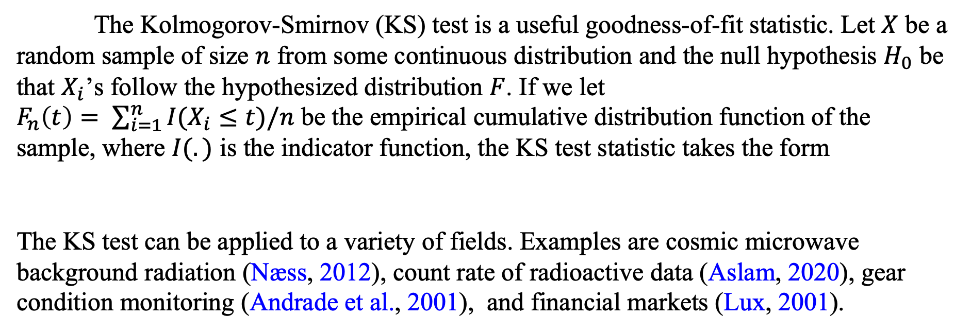
Nonparametric Bootstrap Kolmogorov-Smirnov Goodness-of-Fit Test for Marginal Distributions of Stationary Time Series
Mathew Chandy¹, Elizabeth Schifano¹, Jun Yan¹, Xianyang Zhang² 1 University of Connecticut; 2 Texas A&M University
Background
Non-Parametric Block Bootstrap (cont’d)
Creation of Figures
The Kolmogorov-Smirnov (KS) test is a useful goodness-of-fit statistic. Let $X$ be a random sample of size $n$ from some continuous distribution and the null hypothesis $H_{0}$ be that $X_{i}$’s follow the hypothesized distribution $F$. If we let
$F_{n}\left(t\right)= \sum_{i=1}^{n}{I(X_{i}≤t)/n}$ be the empirical cumulative distribution function of the sample, where $I(.)$ is the indicator function, the KS test statistic takes the form
The KS test can be applied to a variety of fields. Examples are cosmic microwave background radiation (Næss, 2012), count rate of radioactive data (Aslam, 2020), gear condition monitoring (Andrade et al., 2001), and financial markets (Lux, 2001).
Therefore, we can define
We generated time series with marginal distributions $N(8,8)$and $Γ(8,1)$with Kendall’s $τ ∈ \{−.75, −.5, −.25, 0, .25, .5, 75\},$and sample size $n ∈ \{100, 200, 400, 800\}.$Kendall’s$τ$was chosen as a measure of serial dependence as it does not vary between two different marginal distributions. To generate the samples to which our method would be applied, we simulated a time series $W_{t}$ from a 1st order autoregressive (AR(1)) process: $W_{t} = φW_{t}−1 + ε_{t}$, where $φ$ is an autoregressive coefficient, and $ε_{t}$is a series of independent errors from a normal distribution with mean zero and variance $σ_{ε}^{2}$.The strength of the serial dependence is controlled by $φ$, which was set to five levels: $\{−0.924, −0.707, −0.383, 0, 0.383, 0.707, 0.924\},$as these correspond to the desired values for $τ$ . First, we generated a marginal $N(8, 8)$by marginally transforming $W_{t}$ by $X_{t} = F^{−1}[Φ(W_{t})]$, where $F^{−1}(p)$is the quantile function for the $N(8, 8)$distribution. Then we generated a marginal gamma series by the same procedure but replacing $F^{−1}(p)$with the quantile function for the $Γ(8, 1)$distribution. After the transformation to the marginal gamma distribution, the autocorrelations are $\{−0.884, −0.686, −0.389, −0.033, 0.327, 0.639, 0.861\}.$
For our evaluation of size, we generated 1000 samples for each scheme, and tested that each sample indeed adhered to the distribution family from which it was generated. Using the qqplotr and ggplot2 packages (Almeida et al., 2018; Wickham, 2016), we constructed Q-Q plots of the distribution of the p-values to see if they are uniformly distributed (Figures 1 and 3). A uniform distribution of the p-values indicates that under the null hypothesis, our method will only reject the $H_{0}$ at a rate of $α$. Zoomed-in plots for probabilities between 0 and 0.1 are also provided (Figures 2 and 4), as that is the most common range for significance levels $α$. Kendall’s$τ$was chosen as a measure of serial dependence as it does not vary between two different marginal distributions.
For our evaluation of power, we tested that each sample adhered to a different distribution family. If the sample was $N(8, 8)$, we tested that it was gamma distributed, and if the sample was $Γ(8,1)$, we tested that it was normal. We again used the ggplot2 package (Wickham, 2016) to establish the rejection rate’s relationship with the strength of serial dependence, whether the dependence is negative or positive, the length of the series, and the marginal distribution (Figure 5). We rejected $H_{0}$ if the p-value was less than 0.05.
Our simulation studies suggest that 1) the test maintains its size, and 2) its power is substantial, given that the dependence is not too strong for a given sample size.
The procedure of the non-parametric basic bootstrap test is summarized as follows. Repeat the following steps for $b ∈ \{1, …, B\}.$
Generate $X_{n}^{(b)},…, X_{n}^{(b)}$ by applying basic bootstrap on the original sample as defined previously.
Fit $F_{θ}$to $X_{n}^{(b)},…, X_{n}^{(b)}$ and obtain estimate $θ_{n}^{(b)}$of$θ.$
Obtain the empirical distribution function $F_{n}^{(b)}$of $X_{n}^{(b)},…, X_{n}^{\left(b\right)}.$
Calculate bootstrap KS statistic
where $B_{n}\left(x\right)=\sqrt{n}(F_{n}\left(x\right)−F\left(x; {\hat{θ}}_{n}\right)$is the known bias term considered in Babu and Rao (2004). The p-value of the basic bootstrap KS test can be computed as $p = \#\{T_{n}^{(b)}> T_{n}\} / B$for $b ∈ \{1, …, B\}.$
Despite its widespread use, the KS test can be misapplied when its foundational assumptions are overlooked. The KS test assumes
The data are independently and identically distributed (i.i.d.) and
The hypothesized distribution is continuous and fully specified without the need for parameter estimation.
For violations of 2, Zeimbekakis (2022) proposed a parametric bootstrap, whereas Babu and Rao (2004) address this issue through non-parametric bootstrap.
Evaluation of Size
Consider a stationary time series $\{X_{t}: t = 1, . . . , n\}$with length $n$. Let $H_{0}:X_{t}∼F\left(⋅ | θ\right), t=1, …, n .$ Let $H_{A}$ be that the marginal distribution of $X_{t}$does not follow $F$ for any parameter value $θ$. Let ${\hat{θ}}_{n}$ denote the fitted parameters for the hypothesized distribution fitted onto $X_{t}$, and let $F_{n}$ denote the empirical distribution function based on $X_{i}, …, X_{n}$. Let
We note that
where $F\left(x\right)$is the true cdf (under the null $F\left(x\right)=F(x,θ_{0})$ for some true parameter $θ_{0}$).
Non-Parametric Basic Bootstrap
Let us first consider the case where $X_{i}$’s are independent, but parameters are unspecified. Denote by $F_{n}^{(b)}$the empirical distribution of the $b$th bootstrap sample and let ${\hat{θ}}_{n}^{(b)}$ be the parameter estimate based on the $b$th bootstrap sample. Using the bootstrap (asymptotic) theory, we can approximate the distribution of
$\sqrt{n}(F_{n}(x)−F(x))$with $\sqrt{n}\left(F_{n}^{\left(b\right)}\left(x\right)−F_{n}\left(x\right)\right)$and
$\sqrt{n}(F(x;{\hat{θ}}_{n})−F(x))$with $\sqrt{n}\left(F(x;{\hat{θ}}_{n}^{(b)})−F\left(x; {\hat{θ}}_{n}\right)\right).$
Therefore, we can define
.
Real Data Analysis
Using the tseries package (Trapletti and Hornik, 2023), we gathered closing stock prices for the S&P 500 index. We observed how the method performs using the last 4 years of data: from January 1st, 2020 to December 31st, 2023. We approximated stock returns by taking the difference in the logarithm of the closing prices. Using our method, we tested that the stock returns are normally distributed and Student’s $t$ distributed with degrees of freedom $v∈\left\{30, 20, 10, 5, 4, 3, 2, 1\right\}.$ We tested the same hypotheses using Babu and Rao (2004)’s non-parametric basic bootstrap bias correction and Zeimbekakis (2022)’s parametric bootstrap method. We used $B=10000$bootstrap replicates in this analysis. The p-values for these tests are highlighted in Table 1. Employing the same methodology as our study on the S&P 500 index, we conducted an analysis on the S&P 100 index. The resulting p-values for these tests are presented in Table 2. We can observe that for $v=5$, our method results in different conclusions than the other methods at $α=0.05$, indicating that serial dependence is something that must be accounted for.
The procedure of the non-parametric basic bootstrap test is summarized as follows. Repeat the following steps for $b ∈ \{1, …, B\}.$
Generate $X_{n}^{(b)},…, X_{n}^{(b)}$ by applying basic bootstrap on the original sample as defined previously.
Fit $F_{θ}$to $X_{n}^{(b)},…, X_{n}^{(b)}$ and obtain estimate $θ_{n}^{(b)}$of$θ.$
Obtain the empirical distribution function $F_{n}^{(b)}$of $X_{n}^{(b)},…, X_{n}^{\left(b\right)}.$
Calculate bootstrap KS statistic
where $B_{n}\left(x\right)=\sqrt{n}(F_{n}\left(x\right)−F\left(x; {\hat{θ}}_{n}\right)$is the known bias term considered in Babu and Rao (2004). The p-value of the basic bootstrap KS test can be computed as
$p = \#\{T_{n}^{(b)}> T_{n}\} / B$for $b ∈ \{1, …, B\}.$
Evaluation of Power
Non-Parametric Block Bootstrap
Let us now consider the case where $X_{i}$’s are realizations from a serially dependent time series. We can generate $X_{n}^{(b)},…, X_{n}^{(b)}$ using block bootstrap for $b ∈ \left\{1, …, B\right\}.$
Block-bootstrap can be done with overlapping or moving blocks. Define moving blocks (assuming length of block $l > 1$) as:
.
Now we draw $k$ blocks from the $(n − l + 1)$ blocks of $Zj$’s with replacement and then align them in the order they were picked to form a block bootstrap sample. If $n$ is not a multiple of $l$, the last block selected will be reduced in size so that the final size of the block bootstrap sample is $n$. We used $l= \left\lceil n^{1/3}\right\rceil$ in our study (Buhlmann and Kunsch, 1999) . We can approximate the distribution of
Concluding Remarks
$\sqrt{n}(F_{n}(x)−F(x))$with $\sqrt{n}\left(F_{n}^{\left(b\right)}\left(x\right)−E[F_{n}^{\left(b\right)}\left(x\right)]\right)$and
$\sqrt{n}(F(x;{\hat{θ}}_{n})−F(x))$with $\sqrt{n}\left(F(x;{\hat{θ}}_{n}^{(b)})−F\left(x;{E[\hat{θ}}_{n}^{(b)}]\right)\right),$
where
This method can be used for any study where the goal is to see if a serially dependent time series follows a hypothesized distribution, and the parameters are unknown or unspecified. Future studies could investigate the method’s performance on different marginal distributions and different dependence structures. Additionally, one could propose a similar method for comparing two serially dependent methods. One could also apply the method showcased in this paper to fields like earthquake prediction and astronomy.

